Slide 1
Ethical Hacking
Presented by:
Bijay Shrestha (19)
Dolindra Bd. Raut (21)
Suresh Dahal (23)
Yugin Paudel (26)
Sanskar Bhattarai (29)

Slide 2
Table of Contents
Introduction
History of ethical hacking
Importance of ethical hacking
Risks without ethical hacking
Challenges in ethical hacking
How can the problems be solved
Tools used in ethical hacking
Common cyber attacks
Consideration while hacking ethically
How to become an ethical hacker
Conclusion

Slide 3
Introduction
Breaking into system legally to find weakness
preventing, detecting, and responding to cyber threats
Offensive Security – The attacker
Defensive Security – The defender

Slide 4
History of Ethical Hacking
1960s: At the MIT, “Hacking” term simply meant finding different ways to optimize systems and machines to make them run more efficiently
1971: Bob Thomas created a virus, creeper, to be a non-harmful experiment
But corrupted DEC PDP-10 Mainframe Computers

Slide 5
History of Ethical Hacking (contd.)
Ray Tomlinson created another program, reaper, to find and log out the creeper
The term “ethical hacking” was first used in 1995 by John Patrick, IBM Vice President.
With the rise of internet and PC, hackers started to steal and sell sensitive data

Slide 6
Importance of Ethical Hacking
Identifies security weaknesses before criminals
Protects sensitive data
Helps businesses comply with cybersecurity law
Reduces financial losses due to cyberattacks.

Slide 7
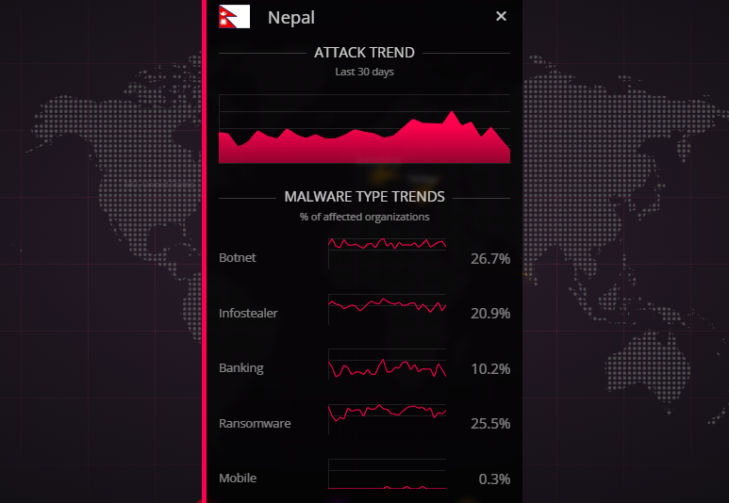
Cyber Attack Trends in Nepal

Slide 8
Risks Without Ethical Hacking
Data breaches
Financial losses
Identity theft and personal data leaks
National Security Threats

Slide 9
Risks Without Ethical Hacking (Contd.)
NIC Asia approx. Rs. 600 Million Hack
FoodMandu Data Breach: Name, Email, Phone Number, Address
FonePay Rs. 34.2 Million Hack
Engineering student’s data leak

Slide 10
Challenges in Ethical Hacking
Misuse of hacking skills
Lack of skilled professionals
Not all businesses can afford cybersecurity teams
Constantly evolving threats

Slide 11
How Can These Problems Be Solved?
Strict cybersecurity policies to ensure ethical hackers work legally.
Provide training & certifications
Using AI & automation – Improve security monitoring

Slide 12
How Can These Problems Be Solved? (contd.)
Implement bounty system
Government & business collaboration
Increase Awareness & Cyber Hygiene

Slide 13
Common Cyber Attacks
SQL Injection – Injecting malicious SQL queries
Phishing – Tricking users into revealing credentials
Social Engineering – the art of human hacking
Denial of Service (DoS) – Overloading a system to make it unavailable

Slide 14
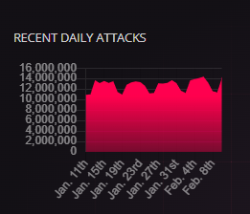
Cyber Threats

Slide 15
Tools Used In Ethical Hacking
Nmap – Network scanning
Metasploit – Exploitation framework
Burp Suite – Web security testing
Wireshark – Packet sniffing and analysis

Slide 16
Considerations while Hacking Ethically
Get written permission from authority
Confidentiality
Understand the Legal Boundaries
Limit Impact on Systems

Slide 17
How to Become an Ethical Hacker
Learn networking and programming
Get certified (CEH, OSCP, CISSP)
Practice with CTF (Capture The Flag)
Stay updated on cybersecurity trends

Slide 18
Conclusion
Ethical hacking finds and fixes security vulnerabilities legally.
It protects data, businesses, and national security.
Ethical hackers follow legal rules and ethical guidelines.
Staying updated is key in cybersecurity.

Slide 19
Any Questions?

Slide 20
Thank you!

